Slide 1


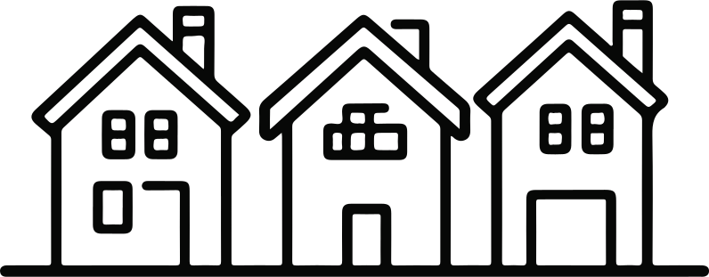
Neuefische Bootcamp
21/11/2025
KING COUNTY HOUSING ANALYSIS
NAME OF PROJECT:
PRESENTED BY:
PRESENTED TO:
Data Science EDA Project
Leya Huseynova
DS & AI Group

Slide 2


01 | Overview
02 | Goals and client’s vision
03 | Analysis
04 | Suggestions
05 | Insights
06 | Team
07 | Contacts
08 | Additional slides for Q&A
Agenda
02/14

Slide 3
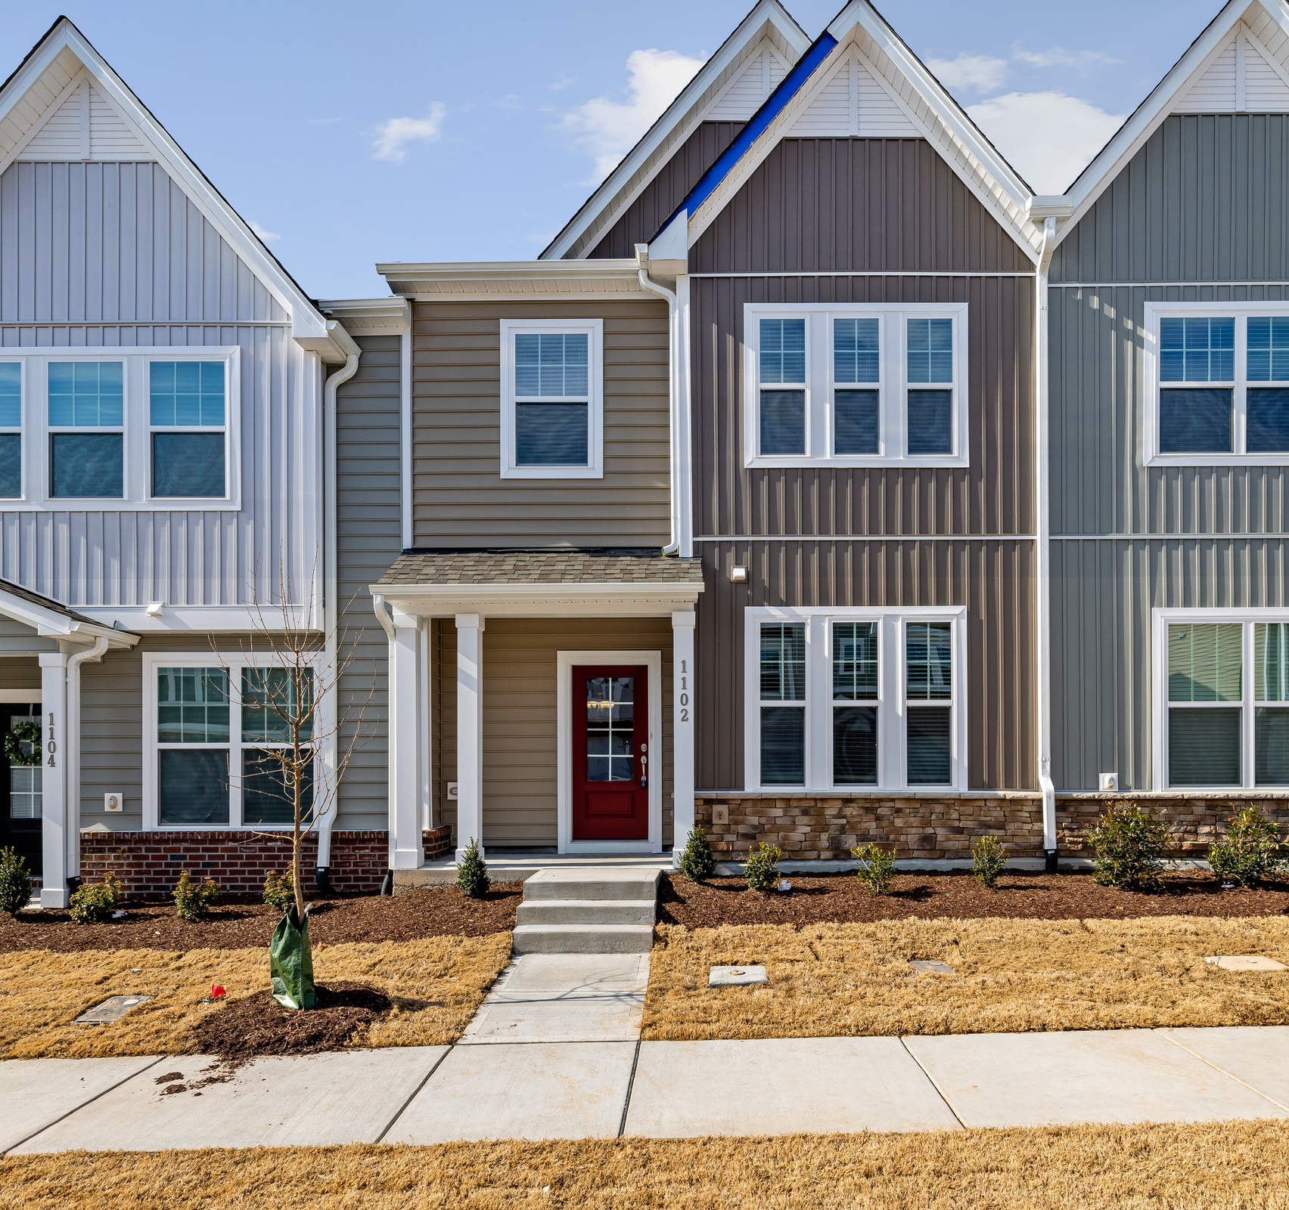
03/14
Overview
This project analyzes the local housing market to help Nicole Johnson make an informed decision about purchasing one of three recommended houses. By combining location data, property characteristics, and price insights, the analysis highlights how each home compares to the broader market and why these three options stand out.

Slide 4


04/14
Goals
Goal # 1
Goal # 2
Goal # 3
Assess how location influences home prices
Determine the impact of renovations on price
Evaluate whether Nicole can find an affordable home in a lively, central neighborhood

Slide 5


05/14
Nicole Johnson is looking to buy a home in the Seattle area, and she has a very clear set of priorities. She wants a lively, central neighborhood with good access to amenities, schools, and transportation. Nicole is shopping in the middle price range, meaning she’s looking for good value but not luxury-level pricing. She also plans to buy within the next year, so understanding the right timing and seasonal price trends is important for her.
Throughout this analysis, every step — from data cleaning to exploring geographical patterns — has been aligned with client’s needs to identify the most suitable ZIP codes and three specific property recommendations
Client’s vision

Slide 6
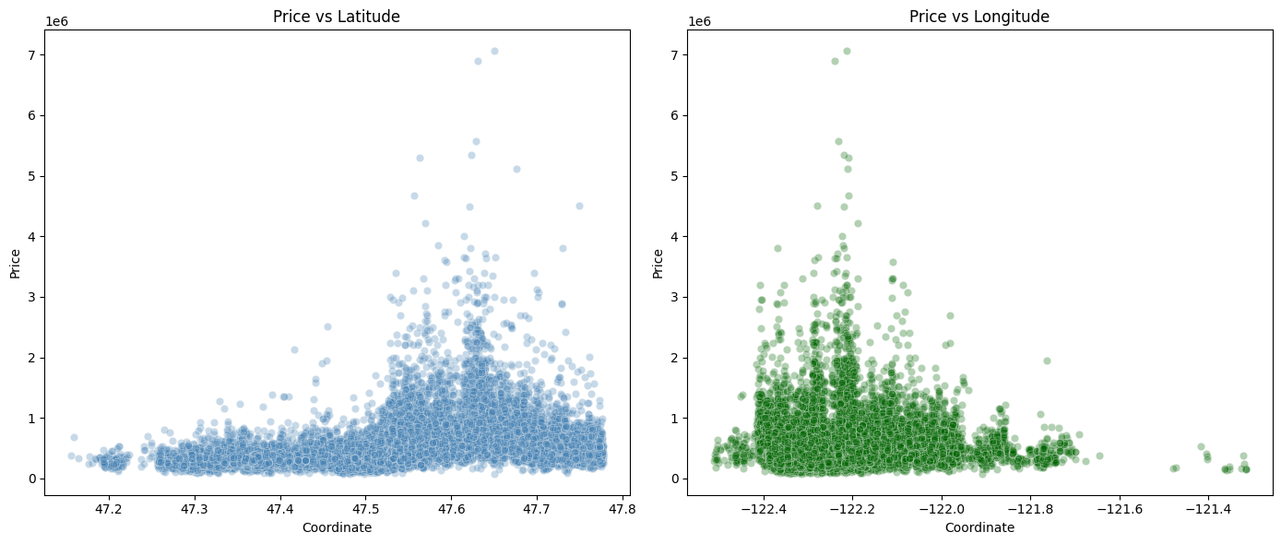
06/14
A1: Homes in central/northern coordinates have higher prices
Latitude increases when you move north.
Longitude increases to the east (less negative) and decreases to the west.
Houses farther north—closer to Seattle city center and upscale northern neighborhoods—tend to be significantly more expensive.
Houses closer to the western coastline are noticeably more expensive

Slide 7
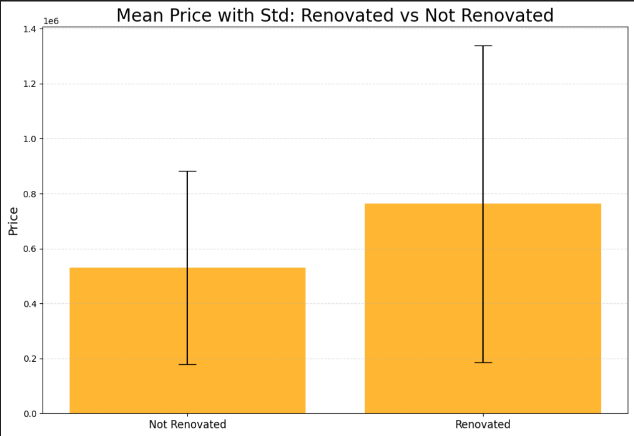
07/14
A2: Renovated homes tend to be more expensive than non-renovated homes
Renovations significantly raise home values in this market.
Renovated properties require less upfront work but come at a higher purchase price.
Non-renovated homes may offer opportunities for value-add investments.
Renovated homes vary more widely in price
The whiskers on the renovated bar are much longer, meaning:
Some renovated homes are moderately priced.
Others are very expensive.
This group includes small remodels and high-end luxury renovations.

Slide 8
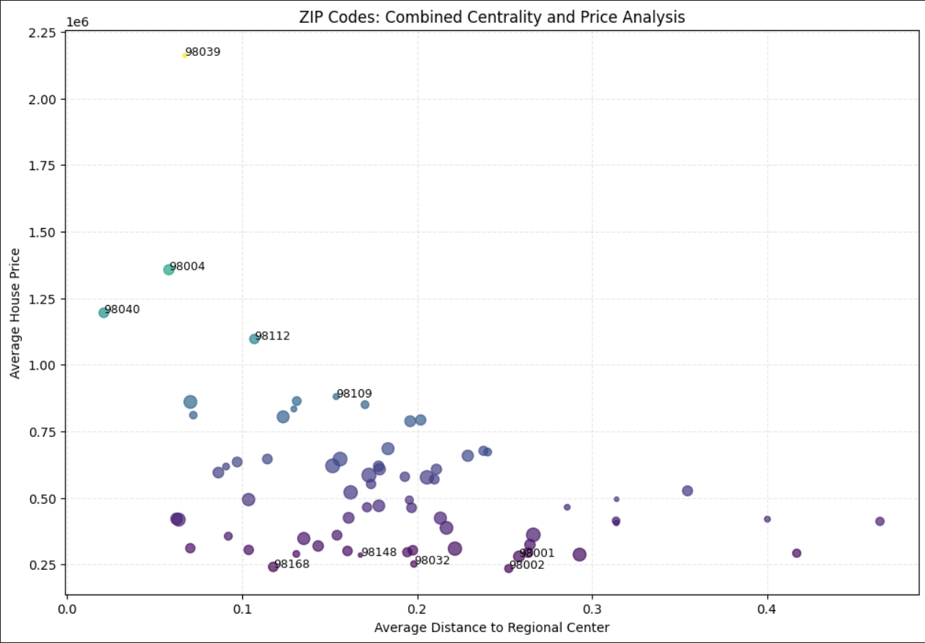
08/14
A3: There are mid-priced houses in the central area for Nicole
Best price → Look bottom-left or bottom-middle
The closer a ZIP code is to the regional center, the more expensive it tends to be. The best value for Nicole’s budget comes from ZIP codes in the lower-middle area of the chart — good locations at more affordable prices.
Great location → Look top-left
Luxury ZIP codes sit in the upper-left of the chart, while great value neighborhoods sit lower and toward the middle. Three recommended homes are positioned in areas that balance price, location, and long-term value.’
Balanced choice → Middle of the chart
Moderate price + moderate distance
Where most ZIPs cluster — good for practical buyers

Slide 9
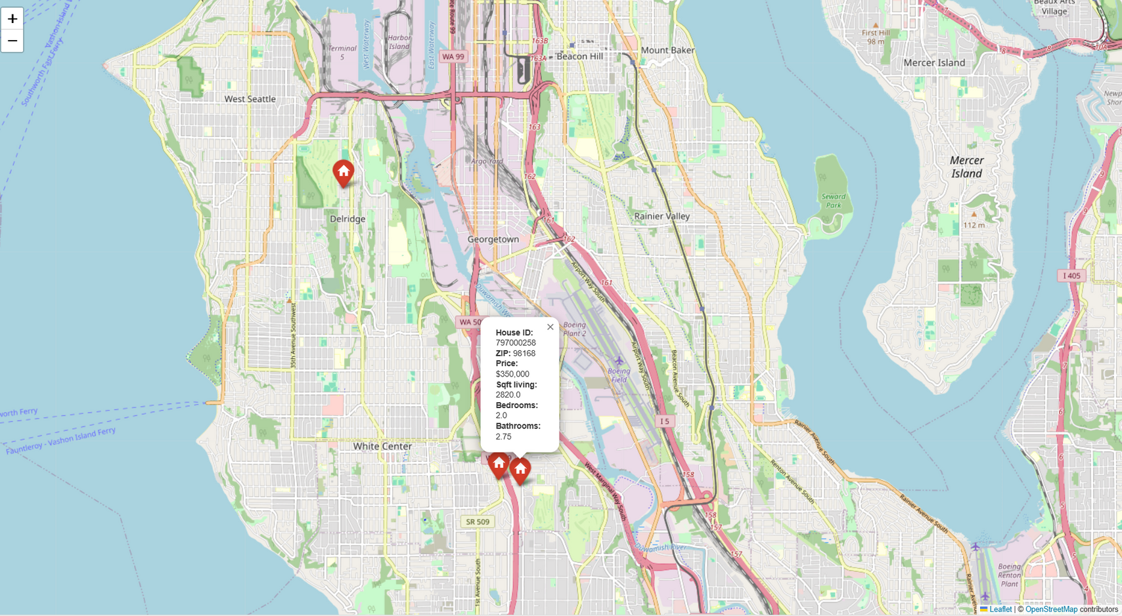
Suggestion 3:
09/14
🏠 House A – Spacious & Best Overall Value (ZIP 98168)
ID: 797000258, Price: $350,000
This home offers exceptional living space at an outstanding price.”
2 bedrooms, 2 full baths + one ¾ bath
2,820 sqft of living space — the largest of all recommendations
Built in 1947 , not renovated, but well-maintained and offers strong potential for future upgrades
Large lot (11,770 sqft) offering privacy, gardening space, and outdoor possibilities
Located in a budget-friendly neighborhood with great access to Seattle
Why it’s great for Nicole:
This home gives Nicole a huge amount of space for a mid-range price, making it perfect if she wants comfort, room to grow, or space to host guests. The lot size and floorplan give great long-term potential.

Slide 10
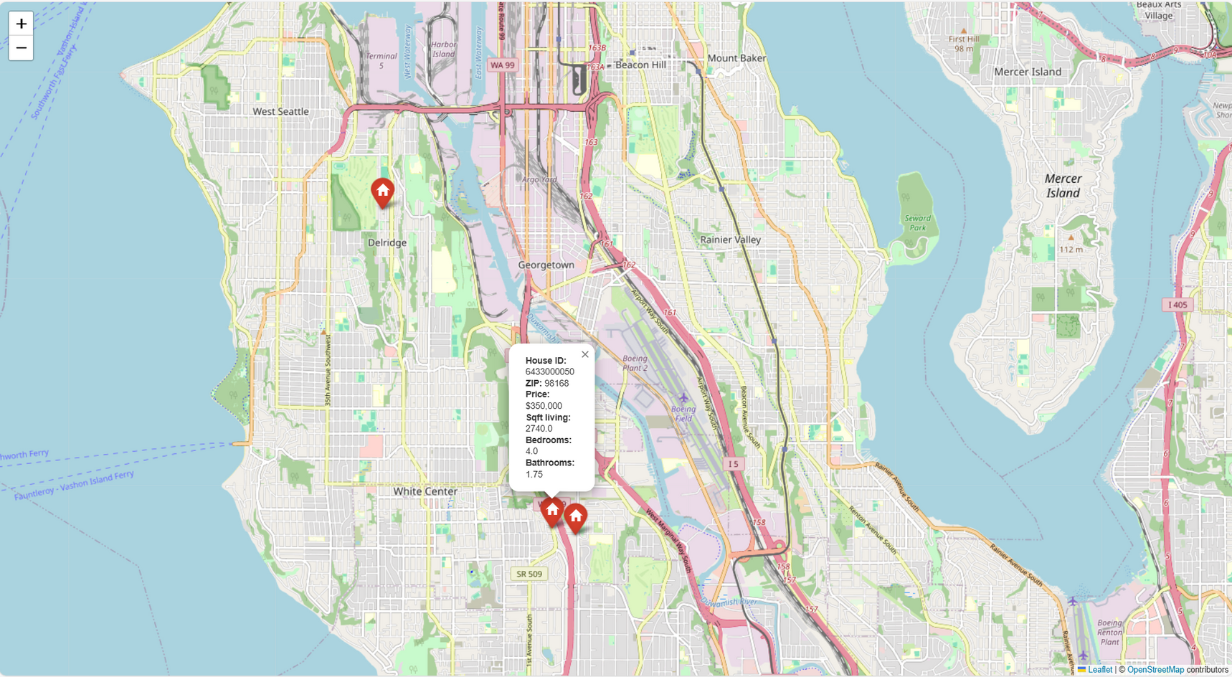
Suggestion 1:
10/14
🏠 House B – Best Family Layout, Great Price for Its Size (ZIP 98168)
ID: 6433000050, Price: $350,000
4 bedrooms, 2 bathrooms
2,740 sqft of living space — generous for families or shared living
Built in 1972
Not renovated, but structurally newer than most homes in this price segment
Large lot (10,086 sqft) offering a balance between outdoor space and low maintenance
Located in the same affordable central-south cluster
Why it’s great for Nicole:
If Nicole wants more rooms — for guests, office space, hobbies, or future flexibility — this home is a perfect fit while still staying well within her mid-range budget.

Slide 11
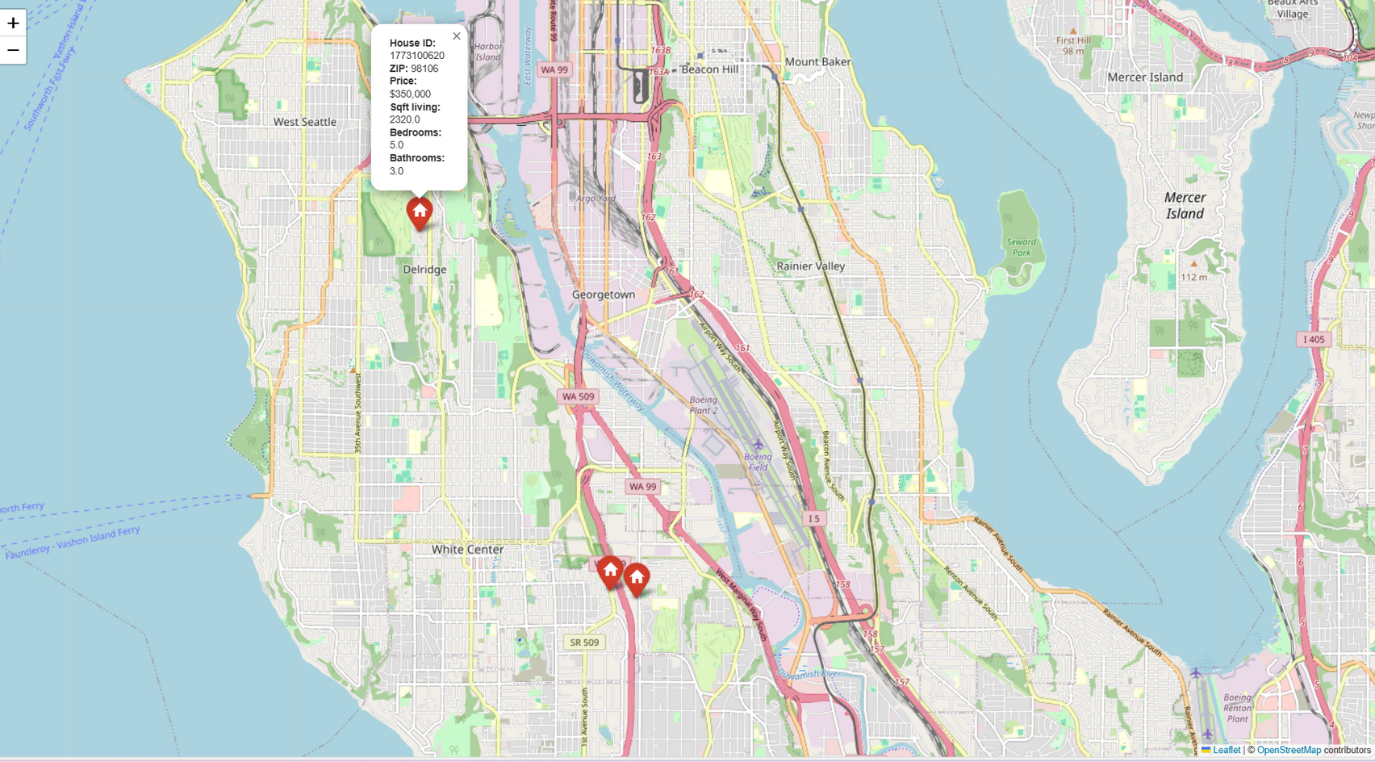
Suggestion 2:
11/14
🏠 House C – Best Location & Most Bedrooms (ZIP 98106)
ID: 1773100620, Price: $350,000
A vibrant and central West-Seattle neighborhood.”
5 bedrooms, 3 bathrooms
2,320 sqft of living space
Built in 1963
Not renovated, but has a very functional layout and strong potential for updates
Good-sized lot (8,400 sqft)
Why it’s great for Nicole:
This house is perfect if Nicole prefers a more lively and community-oriented area while needing more rooms for flexibility. It offers the most bedrooms and sits in the ZIP code that best matches her lifestyle priorities.

Slide 12


Insights
12/14
Insight 2 — Renovated Houses Cost More, but Not Proportionally
Insight 3 — House Prices Show Seasonal Patterns
Insight 1 — Location Has the Strongest Impact on Price
Renovated homes are usually more expensive, but
The price difference is not extreme enough to eliminate unrenovated homes from consideration
Many unrenovated homes offer better value per sqft and strong renovation potential
Why it matters for Nicole:
She doesn’t need to restrict her search to renovated homes — unrenovated homes in good locations offer excellent upside and better prices.
From your date analysis and month extraction:
Prices typically dip during late autumn and winter months
They rise again during spring and summer when demand increases
Buying in winter may give Nicole a negotiation advantage
Why it matters for Nicole:
If she waits for the right month, Nicole may save money even in more desirable neighborhoods.
Latitude and longitude analysis, plus ZIP code averages, revealed:
The most affordable areas that still offer central access are south-central ZIP codes like 98168, 98106, and 98108
Northern ZIP codes are significantly outside Nicole’s middle price range
Why it matters for Nicole:
Her best options are in the southern central corridor, where she can still enjoy lively neighborhoods without exceeding her budget.

Slide 13





Our team
13/14
Ms. Fluffy
Ms. Strict
Mr. Pink
Mr. Plant
CEO
CTO
CMO
COO

Slide 14
14/14
Thank you for your attention!
CONTACT ME
E-mail
hello@realestate_neuekatzen.com
Social Media
@realestate_neuekatzen
Phone
+49 111 11 111
Address
Currywurst Weg 1, 52070 Aachen, Germany

Slide 15
1) Float numbers in the house rooms: Some variables such as bedrooms were stored as floating-point values, resulting in non-realistic values like 1.7 bedrooms. Since bedrooms must always be whole numbers, these were rounded to the nearest integer to reflect valid real estate listings.
2) All three ZIP codes—98106, 98108, and 98168—sit in the cluster of ZIPs representing the best balance of (they are just not visible in the chart): affordability, reasonable distance to the center, sufficient housing supply, stable, practical neighborhoods
This is the region of the chart where value buyers shop.
3) Price vs Longitude: Longitude increases to the east (less negative) /Longitude decreases to the west (closer to the Puget Sound waterfront).

